Slide 1
Understanding your Haleon Sharesave 2022 maturity

Slide 2
About us
WEALTH at work is a leading financial wellbeing, retirement and workplace savings specialist.
Established in 2005, we work with hundreds of organisations across both the private and public sector.
Our financial education services are delivered on a bespoke basis.
341377444

Slide 3

Financial education structure
Follow up call
You will be able to ask questions relating to your own circumstances.
Online Seminar
Next steps
Today’s online seminar will cover financial education.
We will identify your next steps and point you in the right direction.
27949402

Slide 4
What we’ll cover today
  Sharesave 2022
  Your choices
  How tax could apply to your gains
  Tax efficiency – making the most of tax allowances
  Next steps

Slide 5
Sharesave 2022

Slide 6
What determines your gain per share
Share price at maturity
Share price at invitation
Capital Gain
20% Discount
Discounted share price
3 years
For illustrative purposes only

Slide 7
Sharesave 2022 – share price performance
£3.60
Share price used for illustrative purposes only
£2.27
Discounted Share Price
For illustrative purposes only. The Haleon share price could be higher or lower at maturity.

Slide 8

Sharesave 2022 – share price performance
£3.60
Share price used for illustrative purposes only
400p
£1.33 gain
£200 saved per month
£7,200 saved over 3 years
£7,200 buys 3,167 shares at £2.27 per share
3,167 shares X £1.33 = £4,203 capital gain*
300p
per share
£2.27
200p
Discounted Share Price
100p
£0
*Rounding has been applied to this figure

Slide 9
Sharesave 2022 – share price performance
Based on a share price of £3.60, you could receive a gain of £1.33 per share.
Monthly Savings | Total Savings | Shares Under Option | Value Of Shares | Capital Gain
£100 | £3,600 | 1,583 | £5,699 | £2,101
£200 | £7,200 | 3,167 | £11,401 | £4,203
£300 | £10,800 | 4,751 | £17,104 | £6,306
£400 | £14,400 | 6,335 | £22,806 | £8,408
£500 | £18,000 | 7,919 | £28,508 | £10,510
Any difference between your total savings and the cost of shares will be returned to you as cash.

Slide 10

Key dates for Sharesave 2022
The maturity date for the scheme is Sunday 1st February 2026. There are then a series of key dates to be aware of:
Feb
You will be able to make your choice from Monday 2nd February 2026 via EquatePlus.
2
Months
You have until 1st August 2026 (6 months from maturity) to exercise your option.
#6
The Haleon share price may be higher or lower when you exercise your option.
Note – if you have missed any monthly payments, your maturity date and other key dates will be different.

Slide 11
Your choices

Slide 12

Your choices at maturity
Exercise and transfer to an ISA
Exercise and sell
Receive all savings back
Exercise and keep
Unlikely to be suitable unless the share price falls below the discounted share price
Tax efficient growth, potential tax planning opportunity and option to diversify
Access your money at maturity
Continue to invest in Haleon for as long as you wish

Slide 13
Exercise and keep your Haleon shares
Exercise and transfer to an ISA
Exercise and sell
Exercise and keep
As a Haleon shareholder, you will receive any dividends paid
You can benefit from any share price growth in Haleon shares
You will be able to vote at the AGM
Diversifying can help manage risk

Slide 14
Exercise and transfer to an ISA
Exercise and transfer to an ISA
Exercise and sell
Exercise and keep
  Protects your savings from future taxation
  Interest and dividends are tax free
  Any future growth is free of CGT
  Option to diversify investment within the ISA*
  An ISA may be used to reduce any CGT liability you have from Sharesave gains
Cash
ISA
Contribution Limit
£20,000
current tax year
Bonds
Equities
*You can diversify investments outside an ISA, but you would not benefit from any tax efficiency.

Slide 15
Exercise and sell your Haleon shares
Exercise and transfer to an ISA
Exercise and sell
  You won’t lose out if the share price falls in the future
  Share proceeds can be spent as soon as you receive them
  You will not benefit from any future investment returns
  Selling all your shares may create a tax charge that could potentially be mitigated

Slide 16
How tax could apply to your gains

Slide 17



Capital gains tax (CGT)
CGT is a tax on the profit when you sell (or ‘dispose of’) an asset that’s increased in value.
£3,000
24%
Annual exemption each tax year
Gains above the basic rate tax band
Main exemptions
Gains within the basic rate tax band
Main residence
Pensions & ISAs
Transfers
between spouse
/ civil partner
18%
429475516

Slide 18

Capital gains tax
Are you likely to exceed your CGT exemption?
£3.60
Share price used for illustrative purposes only
400p
Using our earlier example….
300p
£1.33 gain
per share
200p
£2.27
Discounted Share Price
100p
£0

Slide 19
Capital gains tax
Are you likely to exceed your CGT exemption?
If you saved £145 a month, you will be able to buy 2,296 shares
£1.33 gain
2,296
£3,047
X
=
per share
shares
gain
£2.27p
Discounted Share Price
If you have realised gains by disposing of other assets in the same tax year, you will need to factor these in when calculating your available CGT exemption.

Slide 20
Your Sharesave 2022 performance
Based on a share price of £3.60.
Monthly Savings | Shares Under Option | Capital Gain | Gain in excess of CGT exemption | Tax charge Basic Rate | Tax charge Higher Rate
£100 | 1,583 | £2,101 | ZERO | ZERO | ZERO
£200 | 3,167 | £4,203 | £1,203 | £217 | £289
£300 | 4,751 | £6,306 | £3,306 | £595 | £793
£400 | 6,335 | £8,408 | £5,408 | £973 | £1,298
£500 | 7,919 | £10,510 | £7,510 | £1,352 | £1,802
Gains are taxed at your marginal rate, meaning some basic rate taxpayers may pay gains at 18% and 24%
Shown as a guide only. The share price is likely to vary at the point you sell your shares. Your tax charge will be different if you have other chargeable gains in the same tax year.

Slide 21
Determining your CGT rate
Basic rate tax payer
Entire gain falls within the basic rate
Tax on chargeable gain = 18%
£50,270
chargeable gain
higher rate tax band
basic rate: 20%
taxable income
£12,570
personal allowance

Slide 22
Determining your CGT rate
Basic rate tax payer (before gain)
Part of the gain falls within the basic rate
Remaining gain falls in the higher rate
Tax on chargeable gain = 18% and 24%
£50,270
chargeable gain
higher rate tax band
basic rate: 20%
taxable income
£12,570
personal allowance

Slide 23
Determining your CGT rate
Higher rate tax payer
Tax on chargeable gain = 24%
£50,270
chargeable gain
higher rate tax band
basic rate: 20%
taxable income
£12,570
personal allowance

Slide 24
Tax efficiency – making the most of tax allowances

Slide 25
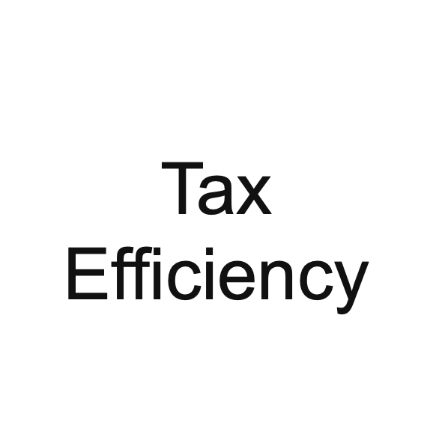


Reducing your tax charge
You may be able to use one, or a combination of these strategies:
Transfer to your spouse / civil partner
Use the 90-day ISA transfer window
Spread the sale of shares over more than 1 tax year

Slide 26
Transferring shares to your partner
You must be married or in a civil partnership for this option to apply.
Option 1
transfer to spouse / civil partner
Sharesave member
Spouse / Civil Partner
Saved £285 per month
Holds 4,514 shares
Share value = £16,250
Total gain = £5,991
Sells 2,260 shares
Realises gain of £2,999
Sells the remaining 2,254 shares
Realises remaining gain of £2,992
The gain is within the CGT exemption in 2025/26 of £3,000
transfers the remaining amount
Neither partner pays any CGT as the gain is within their exemption.

Slide 27
Spread the sale over 2 tax years
A CGT exemption is available to you each tax year, which runs until 5 April.
The same Sharesave member uses an alternative approach…
April
06
2025/26
2026/27
Sells 2,260 of shares
Sells remaining 2,254 shares
Realises gain of £2,999
Realises remaining £2,992 of gain

Slide 28





Transferring shares to an ISA
Using the ISA Transfer window (ISA allowance is £20,000 for the current tax year)
Transferring within 90 days of the date you acquire the shares
Sell your shares immediately free of CGT, or keep them in the ISA
Shares may be transferred into an ISA*
Transfer is not a ‘chargeable event’ for CGT purposes
Useful if considering:
  Holding shares
  Sheltering future returns from tax
  Diversifying
*Subject to ISA limits.

Slide 29
Transferring to an ISA
Using the ISA transfer window (ISA allowance is £20,000)
ISA
Sharesave member
Transferred within 90 days
Saved £490 per month
Holds 7,761 shares
Share value = £27,940
Total gain = £10,300
Sells 2,260 shares
Realises gain of £2,999
5,501 shares transferred to ISA
5,501 shares = £19,803
No CGT charge as transferred within 90 days
No future CGT liability within an ISA
Sells first 2,260 shares
Shares in the ISA can be sold at anytime
(valued at £8,136)
Realises gain of £2,999
No CGT assessment
90 days

Slide 30
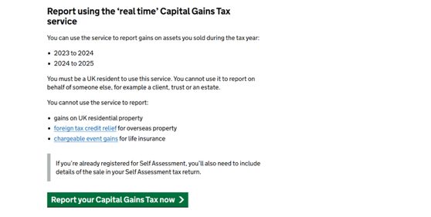


Ways to pay a CGT charge
Report using the ‘real time’ Capital Gains Tax service
Or
Register and send a Self Assessment
www.gov.uk/self-assessment-tax-returns/sending-return
real time
self assessment
www.gov.uk/report-and-pay-your-capital-gains-tax/if-you-have-other-capital-gains-to-report

Slide 31
Taking action
  Check how many Haleon shares you are able to buy on EquatePlus
  Refer to the current Haleon share price to estimate your capital gain
  Check the Haleon share price specific CGT calculator function on the ISA landing page.
  Decide what your plans are for your shares at maturity
  Don’t exercise your option before you have formulated a clear plan
  The 90 days to transfer to an ISA starts when you exercise your options
  Ensure you have maximised the use of all tax allowances available to you
  Consider the benefits of diversifying if you plan to invest for the long term
  Talk through your options and tax efficiency on your follow up guidance call
  Request a letter of appropriation

Slide 32

my wealth invest
my wealth invest are part of the Wealth at Work group and have a stocks and shares ISA available that is specifically designed to accept transfers from your 2022 SAYE maturity.
haleon.waw.mywealthinvest.co.uk
ISAs from other providers are available. You can transfer your shares to any ISA provider that offers this facility.

Slide 33
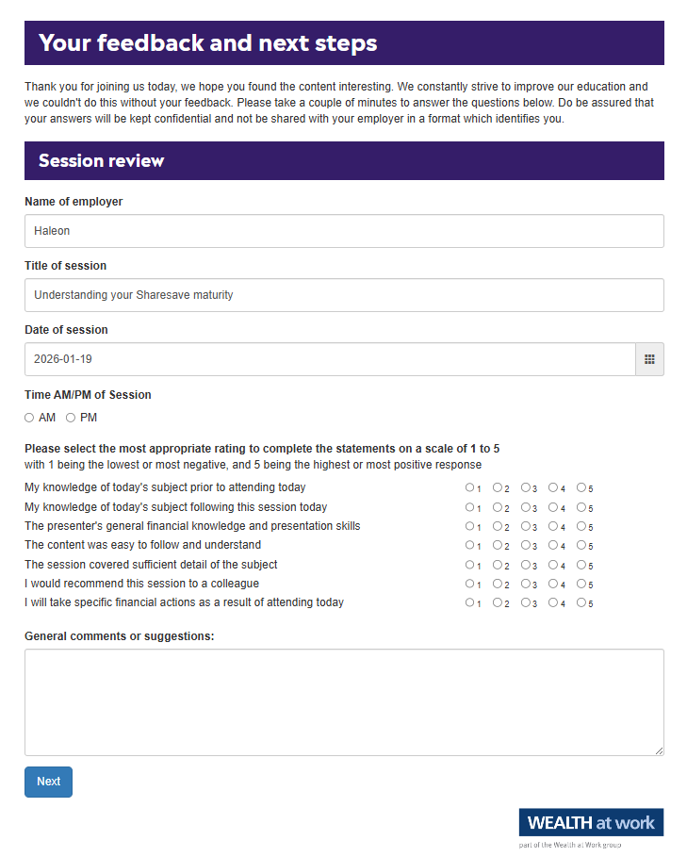
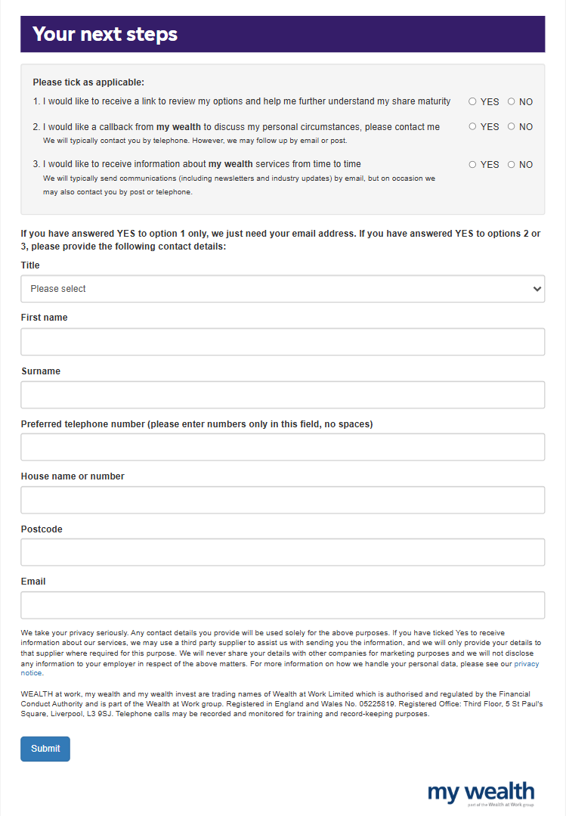
Your feedback

Slide 34
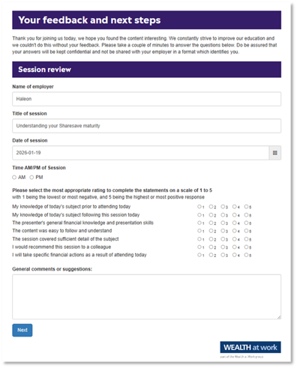
Next steps

Slide 35
Next steps
393965084

Slide 36



Useful contacts
Government - information on tax
01
www.gov.uk/browse/tax
Save As Your Earn (SAYE) information
02
www.gov.uk/tax-employee-share-schemes/save-as-you-earn-saye
Money Helper
03
www.moneyhelper.org.uk
Computershare – Sharesave Maturity
04
Call: 0800 098 8603

Slide 37
Seeking advice
    An adviser will assess your circumstances, objectives and risk profile and provide you with a personal recommendation to meet your objectives.
    All regulated firms are listed on the Financial Services Register, this provides confirmation that the firm is authorised, the specific services they are authorised to provide and details of the advisers who work for them.
    Financial Services Register link:
    https://register.fca.org.uk
252395834

Slide 38

Contact us
We provide a telephone helpline and a regulated investment advice service through my wealth - a trading name of Wealth at Work Limited which is part of the Wealth at Work group.
It helps individuals to understand their personal financial situation especially when selecting their retirement income options.
      Request a callback from the helpline via the feedback form to discuss your personal circumstances with my wealth and agree your next steps and receive regulated investment advice where required
      You can also telephone 0800 028 3200
141862785

Slide 39
Education caveat
All copyright or other intellectual property rights in the material constituting this presentation which has been provided by Wealth at Work Limited remains the property of the Wealth at Work group.
The content of this presentation is provided for illustrative purposes only and is not intended to be used for individual investment or financial planning and does not constitute financial advice.
Whilst every effort is made to ensure the accuracy of information contained in the presentation it cannot be guaranteed. In particular the rules relating to tax can frequently change.
Any references to tax or the operation of tax or tax reliefs are illustrative only and the tax treatment in respect of any individual depends upon the circumstances of each individual.
It is important to recognise that the value of investments related to the stock market (and any resulting benefits such as interest or dividends), can rise or fall and an investor may not get back the amount invested. Past performance data used is for illustrative purposes only and is not necessarily a guide to future performance.
Any hyperlinks or references to third parties or their websites are provided for information only and it does not mean that we endorse their products or services. We have no control over these and accept no legal responsibility for any content, material or information contained in them.
WEALTH at work and my wealth are trading names of Wealth at Work Limited which is authorised and regulated by the Financial Conduct Authority and part of the Wealth at Work group. Registered in England and Wales No. 05225819. Registered Office: Third floor, 5 St Paul’s Square, Liverpool L3 9SJ. Telephone calls may be recorded and monitored for training and record-keeping purposes.
881862975

Slide 40
Thank you
0800 028 3200
www.wealthatwork.co.uk/mywealth
156297902

